Slide 1
2. Algorithm analysis
A algorithm is sequence of steps that gives method of solving a problems. It create the logic of program. Efficiency of algorithm depends on two major criteria, first one is run time of that algorithm and second one is the space.
Run time of algorithm means the time taken by program for execution. We implements the different data structure, some data structure takes more space but improves the run time some takes less space bit it effects run time of algorithm
Data Structure BY S.R. Sharma

Slide 2
Cont..
We can take a simple case of hash table and linked list hash table takes more space but searching is fast, linked list takes less space than hash table but searches sequentially and slow. In such case we use the hashing table rather than the linked list.
While consider the algorithm analysis in time factor we define the following three case.
Best case
Worst case
Average case
Data Structure BY S.R. Sharma

Slide 3
Best case
Generally most of the algorithms behave sometimes in best case, in this case ,algorithm searches the element in first time itself.so taking this case for complexity of algorithm doesn’t tell too much .let us take a case of linear search ,if it finds the element at first time itself then it behaves as best case.
It is minimum time that an algorithm can take. Generally it lies below the average case.
Data Structure BY S.R. Sharma

Slide 4
2.Worst case
Generally we see the complexity of algorithm in it’s worst case behavior, because it tells the behavior of algorithm in worst case and we want to improve the worst case behavior of algorithm. In this case we find the element at the end or when searching of elements fails. Lets again take case in a linear search. Suppose the elements foe which we algorithm is searching, is the last elements in array or its not available in array then algorithm behaves as worst case.
It is the maximum time that the algorithm can take, generally it lies above the average case.
Data Structure BY S.R. Sharma

Slide 5
3. Average
Analysis the average case behavior of algorithm is little bit complex than best case and worst case. Here we take the probability with list of data. Average case of algorithm shoulder be the average number of steps but since data can be at any place, so finding extra behavior of algorithm is difficult. As the volume of data is increase average case of algorithm behaves like worst case of algorithm.
Data Structure BY S.R. Sharma

Slide 6
1. What is Complexity?
Complexity refers to the rate at which the required storage or consumed time grows as a function of the problem size.
The absolute growth depends on the machine used to execute the program, the compiler used to construct the program, and many other factors.
We would like to have a way of describing the inherent complexity of a program (or piece of a program), independent of machine/compiler considerations.
Data Structure BY S.R. Sharma

Slide 7
Cont..
This means that we must not try to describe the absolute time or storage needed.
We must instead concentrate on a “proportionality” approach, expressing the complexity in terms of its relationship to some known function. This type of analysis is known as asymptotic analysis.
Data Structure BY S.R. Sharma

Slide 8
Asymptotic analysis
Asymptotic analysis is based on the idea that as the problem size grows, the complexity can be described as a simple proportionality to some known function. This idea is incorporated in the
1. .“Theta”
2. “Big O”,
3 “Omega” and
3notation for asymptotic performance.
Data Structure BY S.R. Sharma

Slide 9
1.The Θ-Notation (Tight Bound) theta notation
This notation bounds a function to within constant factors. We say f(n) = Θ(g(n)) if there exist positive constants n₀, c₁ and c₂ such that to the right of n₀ the value of f(n) always lies between c₁g(n) and c₂g(n), both inclusive. The Figure below gives an idea about function f(n) and g(n) where f(n) = Θ(g(n)) . We will say that the function g(n) is asymptotically tight bound for f(n).
Data Structure BY S.R. Sharma

Slide 10
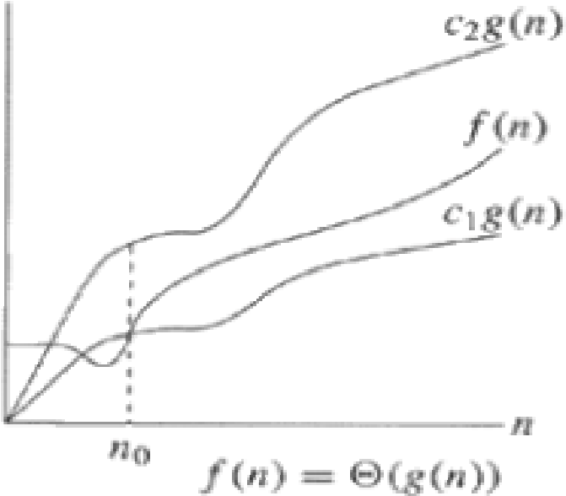
Cont..
Data Structure BY S.R. Sharma

Slide 11
2. The big O notation (Upper Bound)
Big O” notation
This notation gives an upper bound for a function to within a constant factor. Figure below shows the plot of f(n) = O(g(n)) based on big O notation. We write f(n) = O(g(n)) if there are positive constants n₀ and c such that to the right of n₀, the value of f(n) always lies on or below cg(n).
Data Structure BY S.R. Sharma

Slide 12
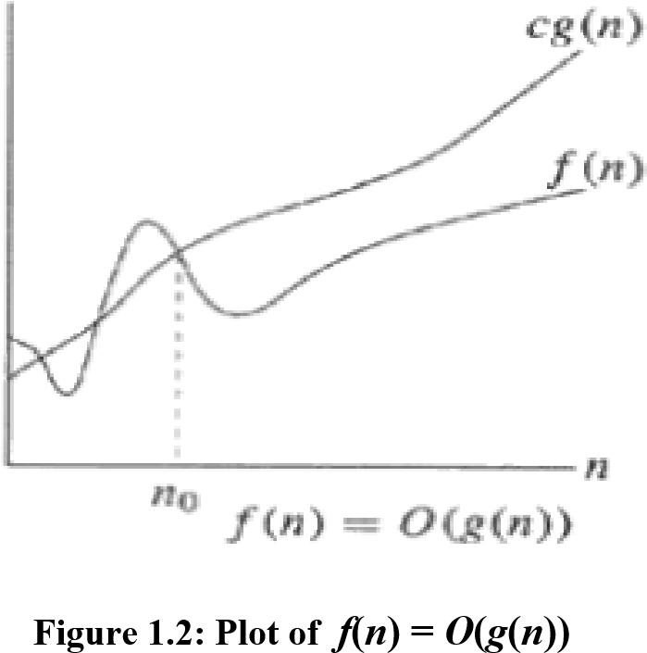
Cont..
Data Structure BY S.R. Sharma

Slide 13
3. The Ω-Notation (Lower Bound)
"Omega”
This notation gives a lower bound for a function to within a constant factor. We write f(n) = Ω(g(n)), if there are positive constants n₀ and c such that to the right of n₀, the value of f(n) always lies on or above cg(n). Figure 1.3 depicts the plot of f(n) = Ω(g(n)).
Data Structure BY S.R. Sharma

Slide 14
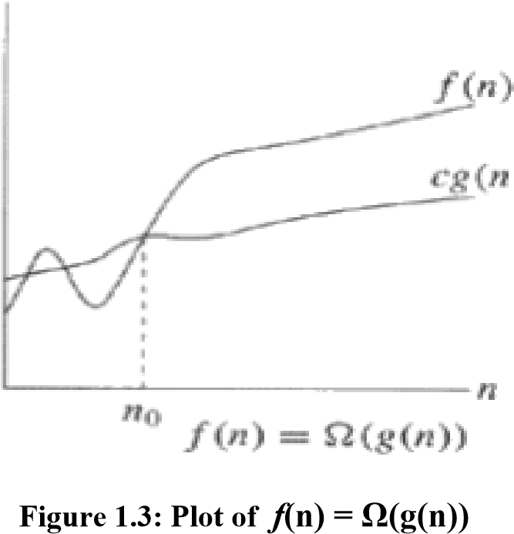
Cont..
Data Structure BY S.R. Sharma

Slide 15
model
In order to analyze algorithm in a formal frameworks, we need a model of computational. The model is basically a normal computer, in which instructions executed sequentially. In models we have standard simple instructions such as additional, multiplication, comparison, and assignments, but unlike the case with real computers, it takes exactly one time unit to do anything.
Data Structure BY S.R. Sharma

Slide 16
Running time calculations
Example
int sum (int n)
{
int i, partialsum;
1 partialsum=0; 1unit
2 for(i=0;i<-n;i++)
3 partialsum+=i*i*i; 4units its goes up to n so 4n
4 return partialsum; 1unit
}
Data Structure BY S.R. Sharma

Slide 17
Cont..
The analysis of above program is simple. The declaration count for no times. Line 1 and 4 count for one unit each. Line 3 counts for four units per time executed(two multiplication, one addition, and one assignments) and is executed N times for total 4N. Line 2 has the hidden costs of initializing i, testing i<=N, tests, and N for all the increments, which is 2N+2. we ignore the cost of calling function and returning, for total of
4N+2+2N+2 = 6N +4
Total time is 6N+4 units.
Data Structure BY S.R. Sharma

Slide 18
ANY Query
?
Data Structure BY S.R. Sharma

